Slide 1
Edubridge Project
Supermarket Store Sales Analysis
Presented By : Rupesh Ghodpage

Slide 2
Problem Statement:
The problem to be investigated in this study is the analysis of the sales history on the each store at the supermarket sales data set using the store data set

Slide 3
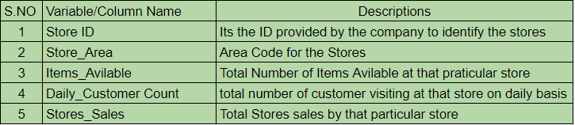
Introduction:
The Supermarket Sales dataset consists of historical sales data of a supermarket company from 896 different stores. Following table provides a summary of the variables and the variable description.

Slide 4
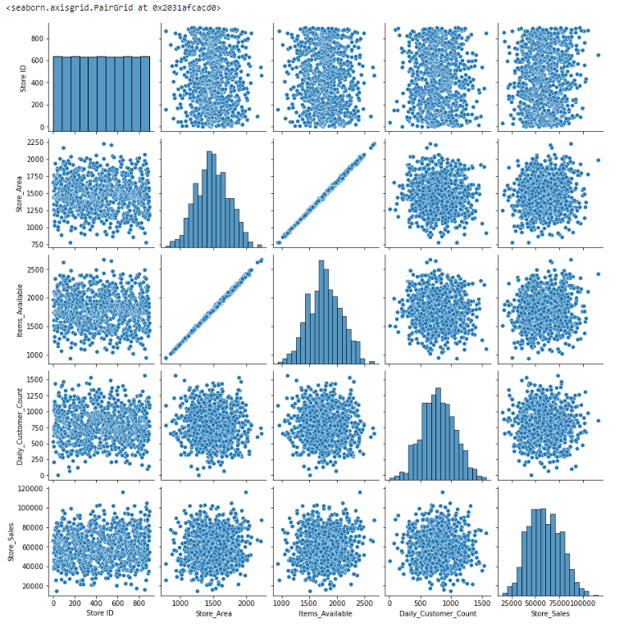
Exploratory Data Analysis:
Pairplot Analysis
Pair plot is used to understand the best set of features to explain a relationship between two variables or to form the most separated clusters.

Slide 5
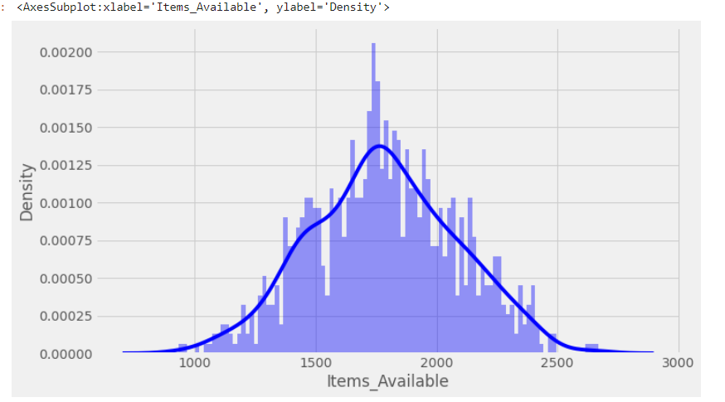
Distplot Analysis
Dist plot gives us the histogram of the selected continuous variable. It is an example of a univariate analysis. We can change the number of bins i.e. number of vertical bars in a histogram import seaborn as sns.
Here from this distplot graph we can check that Items_Avilable data distribution of a variable against the density distribution

Slide 6
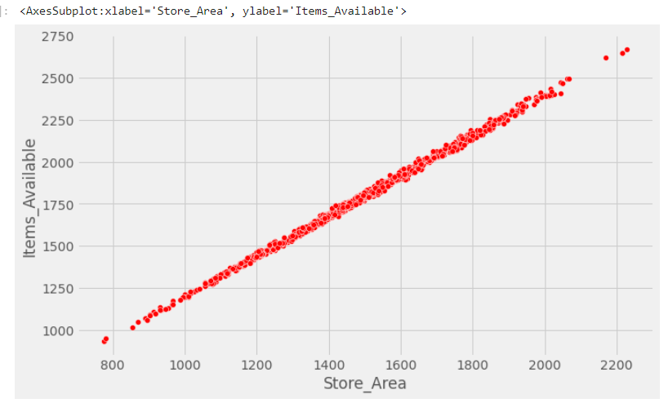
Scatterplot Analysis
A scatter plot is a visual representation of how two variables relate to each other. You can use scatter plots to explore the relationship between two variables, for example by looking for any correlation between them.
Here we can see the data visualization technique that shows the relationship between two numerical variables that are Store_Area & Items_Available

Slide 7
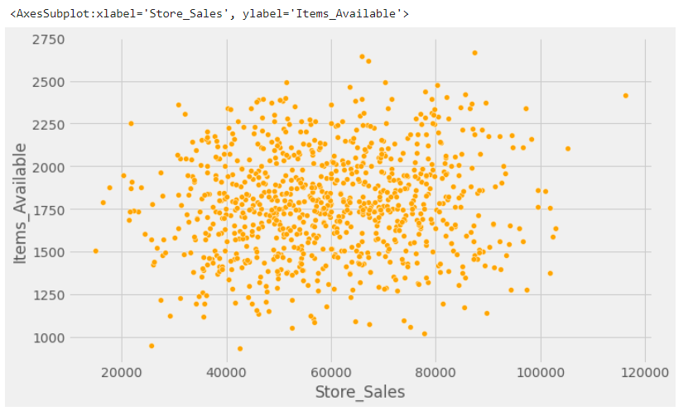
Scatterplot Analysis
Similarly, we can see the data visualization technique that shows the relationship between two numerical variables that are Store_Sales & Items_Available

Slide 8
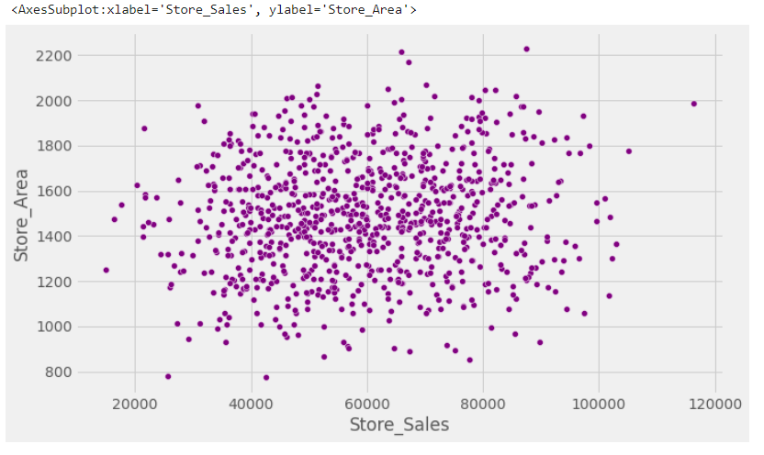
Scatterplot Analysis
Similarly, we can see the data visualization technique that shows the relationship between two numerical variables that are Store_Sales & Stores_Area

Slide 9
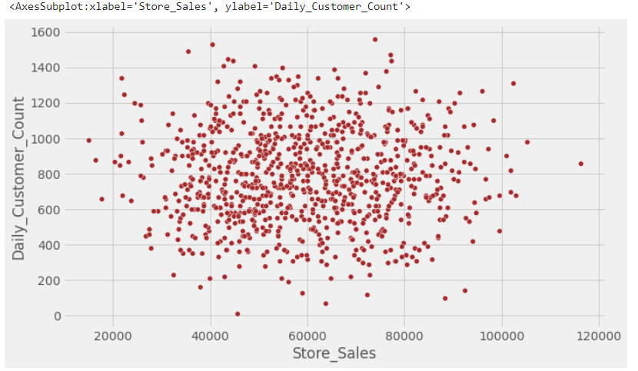
Scatterplot Analysis
Similarly, we can see the data visualization technique that shows the relationship between two numerical variables that are Store_Sales & Daily_Customer_Count

Slide 10
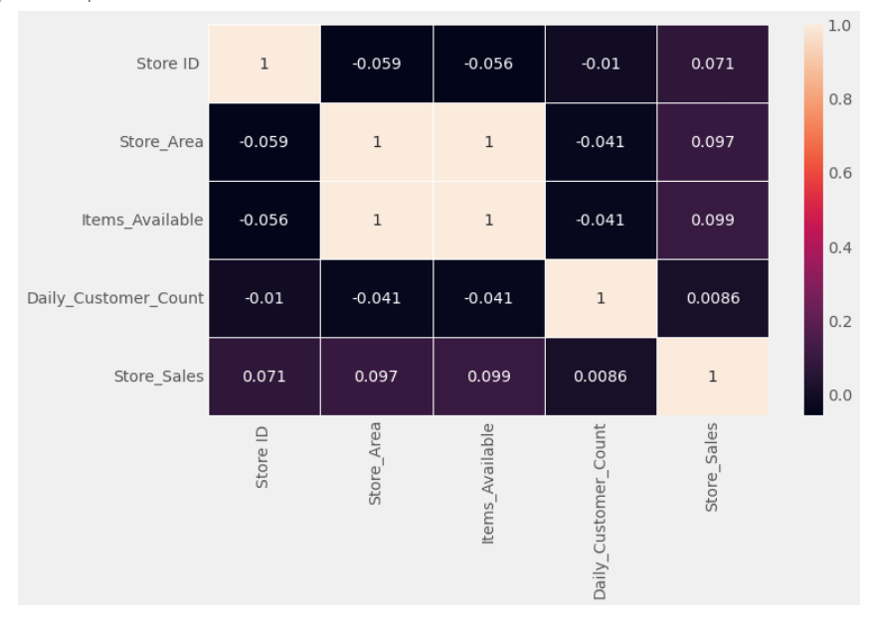
Heatmap Analysis
If the value is 1, it is said to be a positive correlation between two variables. This means that when one variable increases, the other variable also increases.
If the value is -1, it is said to be a negative correlation between the two variables. This means that when one variable increases, the other variable decreases.
If the value is 0, there is no correlation between the two variables. This means that the variables changes in a random manner with respect to each other.

Slide 11
Methodology:
Here we have used two Machine Learning Algorithm, which are part of Supervised Learning
Linear Regression
Polynomial Regression
Linear regression analysis is used to predict the value of a variable based on the value of another variable. The variable you want to predict is called the dependent variable. The variable you are using to predict the other variable's value is called the independent variable.
Polynomial regression is a technique we can use to fit a regression model when the relationship between the predictor variable(s) and the response variable is nonlinear.

Slide 12
Inferences:
We have drawn some inferences from the data frame. Here is a summary of a few of them:
Today we are all connected with digital and every In all seasons, supermarkets should be aware of customer demand and avoid
stockouts.This project focus on predicting the future demand of sales using various machine learning algorithms.
Analyzing the past sales of the store
Understanding the factors that affect the sales of a store
Deriving inferences related to those sales
Predicting the future sales from the inferences derived
Help the businesses stock up/stock down products accordingly

